Slide 1
Exploratory Data Analysis 2: Sampling and Estimation, Statistical Interfaces

Slide 2
Population
Population refers to the total membership or “universe” of a defined class of people, organizations, objects , entities or events.
A statistical population is a set of entities, which engages the researcher’s interest as a set. E.g. the set of all petrol retailers in Pune City.
Finite population and infinite population.

Slide 3
Sample
Statisticians use the word sample to describe a portion chosen from the statistical population so as to seek data or information, opinions or facts from the selected units.
Thus, a finite subset of a statistical population , chosen in a specific fashion, is called a sample.

Slide 4
Parameters and statistic
Any set of entities i.e. samples and populations , can be described by using statistical measures such as the mean, median, mode, standard deviation, etc.
When these terms describe the characteristics of a population, they are called population parameter.
When they describe the characteristics of a sample, they are called sample statistic.

Slide 5
Parameter | Statistic
A parameter is a characteristic of a population. | A statistic is a characteristic of a sample.
The parameter is unknown, it is estimated from the calculated values of the sample statistic. | A statistic is calculated from the sample.
In general, we use Greek or capital letters for population parameters. | In general, we use lower case Roman letters to denote sample statistics.
N, µ, σ, are the standard symbols for the size, mean, S.D, of population. | n , x , s, are the standard symbol for the size, mean, s.d of sample respectively.

Slide 6
Sampling Error?

Slide 7
Sampling Error
Sampling error is the difference between a statistic value that is generated through a sampling procedure and a parameter value, which can be determined only through a census study.
An understanding of the magnitude of the sampling error is essential for ascertaining how precisely the population parameter can be estimated from a sample statistic value.

Slide 8
Sampling Error
We cannot accurately determine the magnitude of the sampling error associated with the sampling process for two reasons:
a) First, we do not know the true population parameter value (if we already did, there would be no need for any sampling study).
b) Second, the sample statistic value itself may vary from sample to sample within the same population.

Slide 9
Example : Sampling Error

Slide 10
Let us calculate monthly HH income in a city
Population = 4 HH
Example : A = Rs 100/-
: B = Rs 200/-
: C = Rs 300/-
: D = Rs 400/-
Census or Sample?
Lets take sample of 2 HH

Slide 11
1. Anjali’s Sample : A & B
A – 100
B - 200
Avg HH Income X1 = 150
2. Anamika’s Sample : A & C
A – 100
C - 300
Avg HH Income X2= 200
3. Rajesh’s Sample : A & D
A – 100
D - 400
Avg HH Income X3= 250

Slide 12
4. Dinesh’s Sample : B & C
B - 200
C- 300
Avg HH Income X4 = 250
5. Mahesh ’s Sample : B & D
B - 200
D - 400
Avg HH Income X5 = 300
6. Raja’s Sample : C & D
C - 300
D - 400
Avg HH Income X6 = 350

Slide 13
Actual Population Average = A + B + C + D / 4 = 250
If we project Population Average from Sample Avg. then…
S1 = 150 + Something
S2 = 200 + Something
S3 = 250
S4 = 250
S5 = 300 – Something
S6 = 350 – Something
But in reality we do not take all possible samples, Hence, there is always a possibility of some error.
i.e. Sample Average ± Some error
Some error = Sampling Error

Slide 14
Reducing the Sampling error.
The greater the sample size, the smaller the standard error/sample error.
Because the greater the sample size, the closer the sample is to the actual population itself.

Slide 15
Sample Size
This amount of risk a researcher is willing (or allowed) to take relates directly to the size of the sample.
Simply stated, the less risk, larger the sample must be.
If the researcher cannot accept any risk, he should survey the entire population (take a census).

Slide 16
DETERMINATION OF SIZE OF SAMPLE
Common Misconceptions
The sample should be a proportion (often 5 or 10 per cent) of the population;
The sample should total about 500.
Any increase in the sample size will increase the precision of the sample results.
No such rule-of-thumb method is adequate.

Slide 17
DETERMINATION OF SIZE OF SAMPLE…..
How large should a sample be?
1. The degree of accuracy required. 2. The degree of variability or diversity in the population. 3. The number of different variables examined simultaneously in data analysis.

Slide 18
Sample Size for infinite Population
1. Sample Size= (zs/e)²
where z= Level of significance, s= standard deviation, e= permissible error.

Slide 19
Sample Size for infinite Population
II. Sample Size= z² x (p)x(1-p)/ c²
where z= Level of significance, p= the population proportion
(assumed to be 0.50 since this would provide the maximum
sample size).
c= confidence interval, expressed as decimal.( (e.g., .05 = ±5%)

Slide 20
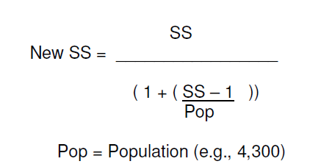
I. Sample Size – Finite Population
Note: Calculate the sample size using the infinite population formula first. Then use the sample size derived from that calculation to calculate a sample size for a finite population.

Slide 21
SIZE OF SAMPLE
Krejcie and Morgan (1970) have prepared a table using the following formula :

Slide 22
II. Formula used by Krejcie and Morgan
Χ² NP (1- P)
s =
d² (N-1) + Χ² P (1-P)
s = Sample Size
Χ² = Chi-square
N = Population
P = Population Characteristics (proportion)
d² = Permissible Error (Standard Error)

Slide 23
TABLE FOR DETERMINING SAMPLE SIZE FROM A GIVEN POPULATION
N | S | N | S | N | S
10 | 10 | 460 | 210 | 2600 | 335
20 | 19 | 500 | 217 | 2800 | 338
30 | 28 | 550 | 226 | 3000 | 341
40 | 36 | 600 | 234 | 3500 | 341
50 | 44 | 700 | 248 | 4000 | 351
60 | 52 | 800 | 260 | 4500 | 354
70 | 59 | 900 | 269 | 5000 | 357
80 | 66 | 1000 | 278 | 6000 | 361
90 | 73 | 1200 | 291 | 7000 | 361
100 | 80 | 1300 | 297 | 8000 | 367
120 | 92 | 1400 | 302 | 9000 | 368
140 | 103 | 1500 | 306 | 10000 | 370
160 | 113 | 1600 | 310 | 15000 | 375
180 | 123 | 1700 | 313 | 20000 | 377
200 | 123 | 1800 | 317 | 30000 | 379
250 | 152 | 1900 | 320 | 40000 | 380
300 | 169 | 2000 | 322 | 50000 | 381
360 | 186 | 2200 | 327 | 75000 | 382
400 | 196 | 2400 | 331 | 1000000 | 384
N=Population S=Sample Size

Slide 24
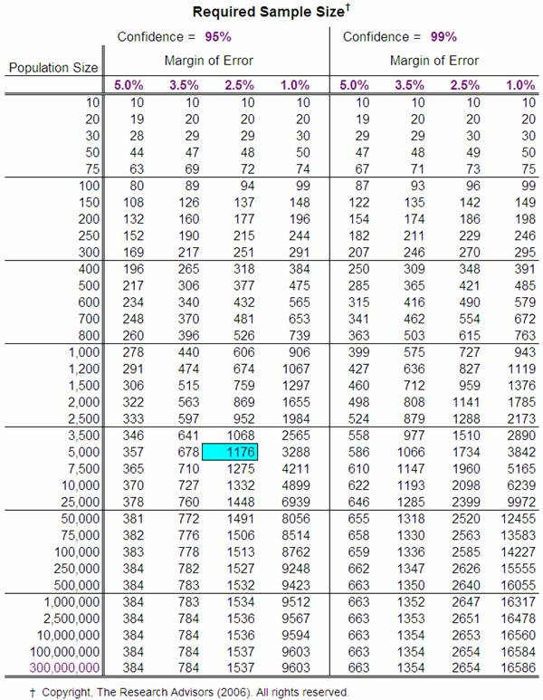

Slide 25
Relationship between Accuracy and Sample Size*
Sr.No. | Sample | Margin of Error
1 | 30 | +/- 17.7%
2 | 200 | +/- 6.5%
3 | 400 | +/- 3.1%
4 | 600 | +/- 3.1%
5 | 800 | +/- 2.4%
*For a population of 1500 and 95% confidence level

Slide 26
Measurement Scale
Non-metric Scale
Metric scale
Nominal
Ordinal
Interval
Ratio

Slide 27
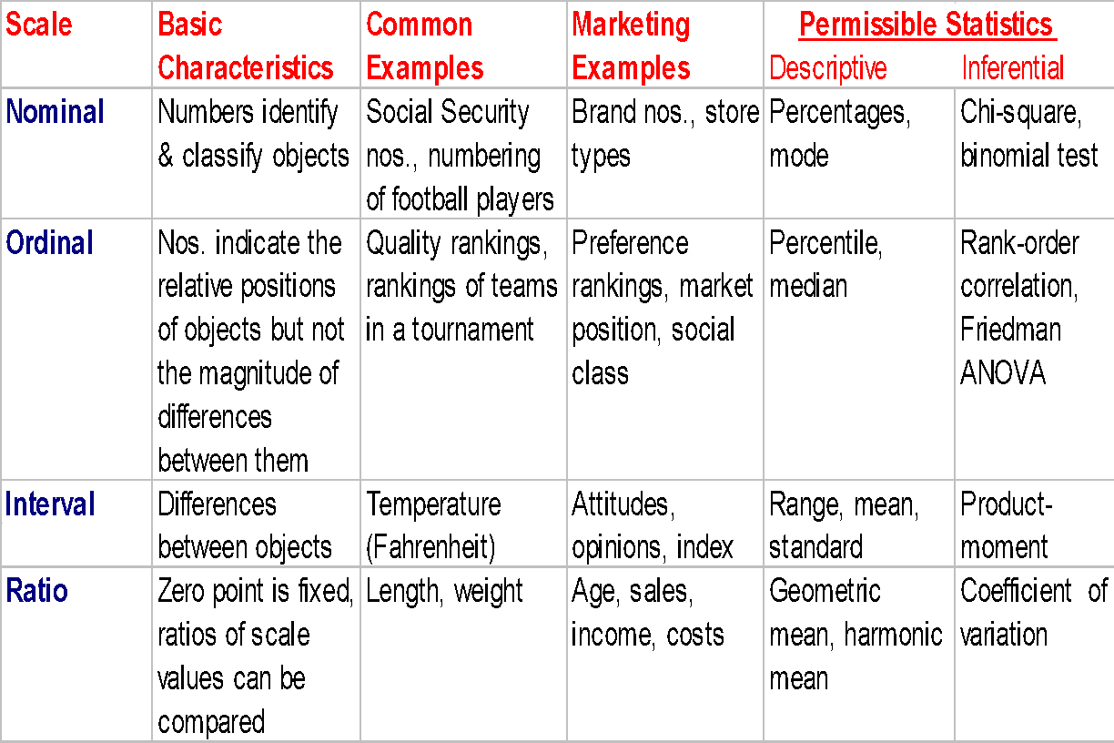
Primary Scales of Measurement

Slide 28
Hypothesis Testing Related to Differences: Univariate and Bivariate Techniques
Hypothesis Testing
Parametric Tests
Nonparametric Tests
One Sample
t-test
z-test
Two Sample
One Sample
Frequency
Chi-square
K-S
Runs
Binomial
Two Sample or more samples
Independent Samples
Two group t-test
z-test
One way ANOVA
Related
Paired t-test
Independent Samples
Chi-square
Mann-Whitney
Median
K-S
K-W ANOVA
Paired Samples
Sign
Wilcoxon
McNemar
Chi-square

Slide 29
Multivariate Analysis
Dependence Technique
Interdependence Technique
Multiple Dependent Variables
Focus on Variables
Focus on Objects
One dependent variable
MANOVA
Canonical
Correlation
Multiple Discriminant Analysis
Factor Analysis
Cluster Analysis
Multi –dimensional Analysis
ANOVA
Multiple Regression
Two group Discriminant Analysis
Conjoint Analysis

Slide 30
SAMPLING DESIGN
METHODS AND TYPES OF SAMPLING
DETERMINATION OF SIZE OF SAMPLE

Slide 31
Sampling Design : Key Issues
Who will be the respondents of study?
How the respondents will be selected?
How many respondents will be studied?

Slide 32
SAMPLING : METHODS
PROBABILITY SAMPLING
NON-PROBABILITY SAMPLING

Slide 33
PROBABILITY SAMPLING
Each element of the population has a known and equal probability of selection in the sample.
It relies on a random selection of elements
It is used in case of ‘Finite Population’

Slide 34
NON-PROBABILITY SAMPLING
It is not possible to specify , for each element of the population, the relative likelihood that it will be included in the sample.
It is used in case of ‘Infinite Population’
Random selection of elements is not necessary.
It relies on personal judgment of the researcher.
The researcher can arbitrarily or consciously decide what elements to include in the sample.

Slide 35
TYPES OF PROBABILITY SAMPLING
Simple Random Sampling
Systematic Sampling
Stratified Sampling
Cluster Sampling
Area Sampling

Slide 36
Simple Random Sampling
A method of sampling that relies on a random or chance selection method so that every element of the sampling frame has a known probability of being selected.

Slide 37
Systematic Random Sampling:
Uses an ordered list.
E.g. selecting every 10th name from the membership register.
Example – 300 Students(Population)
We want to select 15.

Slide 38
Stratified Random Sampling
A method of sampling in which sample elements are selected separately from population strata that are identified in advance by the researcher. The strata will be formed on the basis of Homogeneity .(Homogenous group) .

Slide 39
Types of Stratified Random Sampling
Proportionate Stratified Sampling
Sampling Method in which elements are selected from strata in exact proportion to their representation in the population.
Disproportionate Stratified Sampling
Sampling in which elements selected from strata in different proportions from those that appear in the population.

Slide 40
Proportionate Stratified Sampling
TABLE 1
DISTRIBUTION OF EMPLOYEES
Employees | Population | Proportion/Percentage of each category of employees
Managers | 400 | 10% = 40
Supervisors | 600 | 10%= 60
Workers | 4000 | 10%=400
Total | 5000 | 10% = 500

Slide 41
Disproportionate Stratified Sampling
TABLE 3
SAMPLING DISTRIBUTION OF EMPLOYEES
(DIPROPORTIONATE)
Employees | Population Break-up | Sample Break-up | Proportion of employees
Managers | 400 | 200 | 50%
Supervisors | 600 | 200 | 33%
Workers | 4000 | 200 | 05%
Total | 5000 | 600

Slide 42
Cluster Sampling
Sampling in which elements are selected in two or more stages, with the first stage being the random selection of naturally occurring clusters and the last stage being the random selection of elements within clusters.
Clusters are heterogeneous in nature.

Slide 43
Cluster Sampling…….
Topic : Food Habits of Youth in Pune.
Population : 50,000 (Census 2001)
Sampling Frame : 11000 (An estimate from Food Joints)
Sample : 500
Cluster Sampling : Procedure
Stage I : Selection of One Ward from each circle/zone
of Pune Municipality.
Stage II : Selection of 1000 households from selected
wards.
Stage III : Selection of 500 youth from 1000 Households

Slide 44
Area Sampling
When the clusters are selected on the basis of geographical area , then it is also called as Area Sampling.

Slide 45
NON-PROBABILITY SAMPLING
It is not possible to specify , for each element of the population, the relative likelihood that it will be included in the sample.
It is used in case of ‘Infinite Population’
Random selection of elements is not necessary.
It relies on personal judgment of the researcher.
The researcher can arbitrarily or consciously decide what elements to include in the sample.

Slide 46
Types of non-Probability Sampling
Accidental/Convenience
Quota Sampling
Purposive/Judgmental
Snowball Sampling

Slide 47
Non-probability Sampling
The four important types of non-probability sampling are accidental sampling, quota sampling, snowball sampling and purposive sampling.

Slide 48
Non-Probability Sampling
Convenience sampling/ Accidental Sampling: Samples are drawn at the convenience of the interviewer.
E.g. in mall intercept interviews, the interviewer selects people who are accessible and willing to participate.

Slide 49
b) Judgment sampling/ Purposive Sampling: The researcher believes that the sample of key respondents possesses the attributes valuable to the researcher.
E.g. selecting sarpanch of a gramsabha in a rural study.

Slide 50
c) Quota Sampling- Quota sampling insures inclusion of diverse elements of the population in the sample and make sure that these diverse elements take account of the proportions in which they occur in the population.
For example, we take a sample from a population with equal number of boys and girls, and that there is a difference between the two groups in the characteristic we wish to study and we fail to interview any girls, the results of the study would almost certainly be extremely misleading generalizations about the population.

Slide 51
d) Snowball sampling: Also called referral sampling: one sampling unit, or subject refers another, who refers another, where the characteristics is dispersed thinly in the population and so on. E.g. selecting a sample of mountaineers,
Selection of specialized doctors.

Slide 52
Statistical Interfaces

Slide 53

Tea-Test(t-test)
The t-test assesses whether the means of two groups are statistically different from each other.
This analysis is appropriate whenever you want to compare the means of two groups

Slide 54
Step 1: Null Hypothesis
Step 2: Setting the level of risk
Step 3: Select appropriate t-statistics: t-test for independent means
Step 4: Compute the t-value
Step 5: Determine the critical t-value
Step 6: Compare
Step 7: Decide

Slide 55
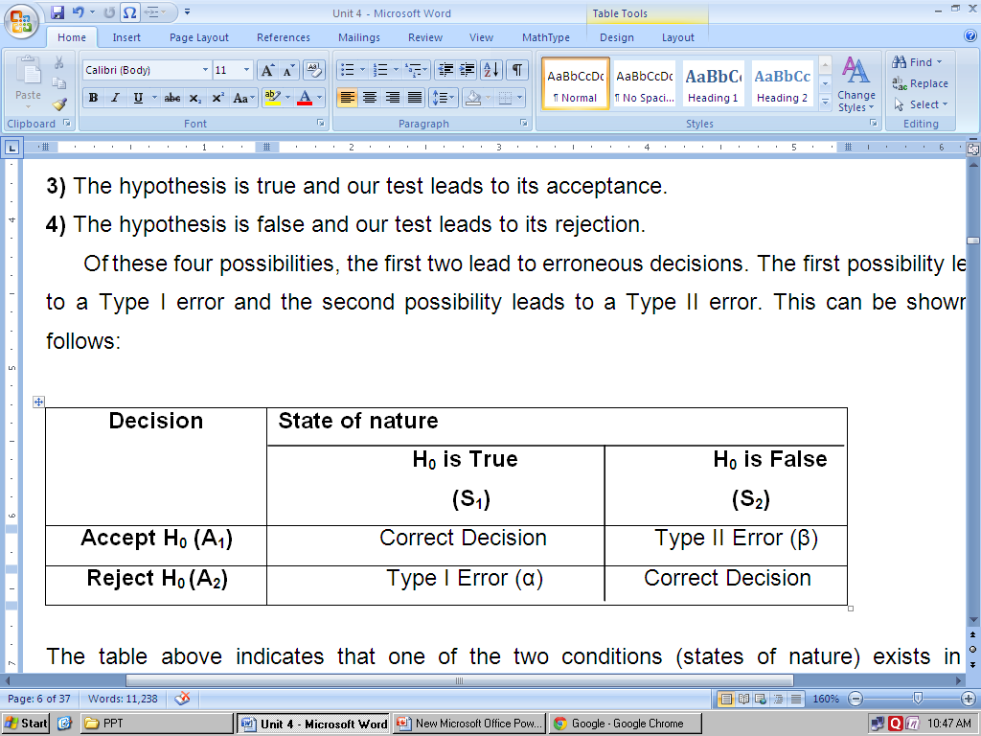
4.2Hypothesis
D) Types of Errors in Hypothesis Testing:
At this stage, it is worthwhile to know that when a hypothesis is tested, there are four possibilities:
1) The hypothesis is true but our test leads to its rejection.
2) The hypothesis is false but our test leads to its acceptance.
3) The hypothesis is true and our test leads to its acceptance.
4) The hypothesis is false and our test leads to its rejection.
Of these four possibilities, the first two lead to erroneous decisions. The first possibility leads to a Type I error and the second possibility leads to a Type II error. This can be shown as follows:

Slide 56
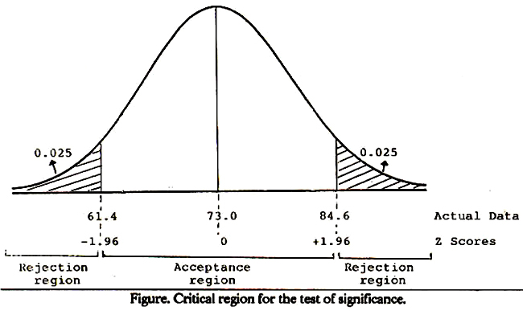

Slide 57
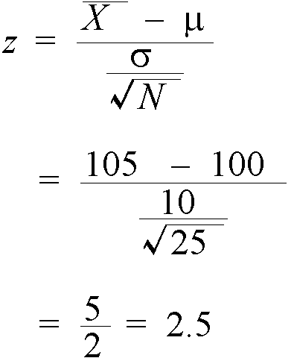
Testing Hypotheses about Single Means when the Population Variance is Known -One sample -A single variable against a known or given standard -
Example: say that I sampled 25 undergraduate students at Scarborough and measured their IQ, finding a mean of 105. Is this mean significantly different from the population which has a mean IQ of 100 and a standard deviation of 10.

Slide 58
Independent t-test (Two Samples)
Suppose , as a marketer of a brand of jeans ,we wanted to find out whether a set of customers in Delhi and a set of customer in mumbai thought of our brand in the same way or not . Suppose we conducted a survey in both cities and got ratings on an interval scale (assume it is 7 point scale rating from 1 to 7) fro our customers. We now want to do a statistical test to find out if the two sets of rating are “significantly different “ from each other or not. We have to now set a level of “ statistical significance” and select a suitable test. We also need to specify null hypothesis.
The Null hypothesis for the t-test would be “ There is no significance difference in rating given by customers in Mumbai and Delhi”

Slide 59
Two sample independent :T-test
Perception of the customers of Mumbai and Delhi for a brand of Jeans.
Two samples: customers from Mumbai and Delhi
The customers are asked at 7 point scale, where = 1 =strongly agree and 7 =strongly agree.
Level of significance= 5% Level of Significance

Slide 60
Paired t- test( Two Samples)
In some cases , we may not have independent samples , but the same sample could be used to do a research study involving measurements. For example , we may measure somebody’s attitude towards a brand before it is advertised and after it is advertised , to try and find out if their attitude has changed due to the campaign. In such cases ,a paired t-test is the appropriate statistical test.
Example: Assume that we used a sample of 18 respondents whom we asked to rate on a 10 point interval scale ,their attitude towards say Provogue Brand of Garments before and after ad campaign was released for this brand. A rating of 1 represents “ Brand is highly Disliked” and a rating of 10 repents “ Brands is highly liked” with other ratings having appropriate meaning.
We set the level of significance at 5%.

Slide 61
Paired Sample –T-test
1. Perception of the customers for a brand of Jeans of Mumbai before and after advertisement.
Sample: same sample before and after the advertisement
The customers are asked at 7 point scale, where = 1 =strongly agree and 7 =strongly agree.
Level of significance= 5% Level of Significance

Slide 62
One-Way ANOVA
One-Way Analysis of Variance

Slide 63
One-Way ANOVA
The one-way analysis of variance is used to test the claim that three or more population means are equal
This is an extension of the two independent samples t-test

Slide 64
One-Way ANOVA
The response variable is the variable you’re comparing
The factor variable is the categorical variable being used to define the groups
We will assume k samples (groups)
The one-way is because each value is classified in exactly one way
Examples include comparisons by gender, race, political party, color, etc.

Slide 65
One-Way ANOVA
Conditions or Assumptions
The data are randomly sampled
The variances of each sample are assumed equal
The residuals are normally distributed

Slide 66

One-Way ANOVA
The null hypothesis is that the means are all equal
The alternative hypothesis is that at least one of the means is different
Think about the Sesame Street® game where three of these things are kind of the same, but one of these things is not like the other. They don’t all have to be different, just one of them.

Slide 67
One-Way ANOVA
The statistics classroom is divided into three rows: front, middle, and back
The instructor noticed that the further the students were from him, the more likely they were to miss class or use an instant messenger during class
He wanted to see if the students further away did worse on the exams

Slide 68

One-Way ANOVA
The ANOVA doesn’t test that one mean is less than another, only whether they’re all equal or at least one is different.

Slide 69
One-Way ANOVA
A random sample of the students in each row was taken
The score for those students on the second exam was recorded
Front: 82, 83, 97, 93, 55, 67, 53
Middle: 83, 78, 68, 61, 77, 54, 69, 51, 63
Back: 38, 59, 55, 66, 45, 52, 52, 61

Slide 70
One-Way ANOVA
The summary statistics for the grades of each row are shown in the table below
Row | Front | Middle | Back
Sample size | 7 | 9 | 8
Mean | 75.71 | 67.11 | 53.50
St. Dev | 17.63 | 10.95 | 8.96
Variance | 310.90 | 119.86 | 80.29

Slide 71
One-Way ANOVA
Variation
Variation is the sum of the squares of the deviations between a value and the mean of the value
Sum of Squares is abbreviated by SS and often followed by a variable in parentheses such as SS(B) or SS(W) so we know which sum of squares we’re talking about

Slide 72
One-Way ANOVA
Are all of the values identical?
No, so there is some variation in the data
This is called the total variation
Denoted SS(Total) for the total Sum of Squares (variation)
Sum of Squares is another name for variation

Slide 73
One-Way ANOVA
Are all of the sample means identical?
No, so there is some variation between the groups
This is called the between group variation
Sometimes called the variation due to the factor
Denoted SS(B) for Sum of Squares (variation) between the groups

Slide 74
One-Way ANOVA
Are each of the values within each group identical?
No, there is some variation within the groups
This is called the within group variation
Sometimes called the error variation
Denoted SS(W) for Sum of Squares (variation) within the groups

Slide 75
One-Way ANOVA
There are two sources of variation
the variation between the groups, SS(B), or the variation due to the factor
the variation within the groups, SS(W), or the variation that can’t be explained by the factor so it’s called the error variation

Slide 76
One-Way ANOVA
Here is the basic one-way ANOVA table
Source | SS | df | MS | F | p
Between
Within
Total

Slide 77


One-Way ANOVA
Grand Mean
The grand mean is the average of all the values when the factor is ignored
It is a weighted average of the individual sample means

Slide 78

One-Way ANOVA
Grand Mean for our example is 65.08

Slide 79

One-Way ANOVA
Between Group Variation, SS(B)
The between group variation is the variation between each sample mean and the grand mean
Each individual variation is weighted by the sample size

Slide 80

One-Way ANOVA
The Between Group Variation for our example is SS(B)=1902
I know that doesn’t round to be 1902, but if you don’t round the intermediate steps, then it does. My goal here is to show an ANOVA table from MINITAB and it returns 1902.

Slide 81
One-Way ANOVA
Within Group Variation, SS(W)
The Within Group Variation is the weighted total of the individual variations
The weighting is done with the degrees of freedom
The df for each sample is one less than the sample size for that sample.

Slide 82


One-Way ANOVA
Within Group Variation

Slide 83

One-Way ANOVA
The within group variation for our example is 3386

Slide 84
One-Way ANOVA
After filling in the sum of squares, we have …
Source | SS | df | MS | F | p
Between | 1902
Within | 3386
Total | 5288

Slide 85
One-Way ANOVA
Degrees of Freedom, df
A degree of freedom occurs for each value that can vary before the rest of the values are predetermined
For example, if you had six numbers that had an average of 40, you would know that the total had to be 240. Five of the six numbers could be anything, but once the first five are known, the last one is fixed so the sum is 240. The df would be 6-1=5
The df is often one less than the number of values

Slide 86
One-Way ANOVA
The between group df is one less than the number of groups
We have three groups, so df(B) = 2
The within group df is the sum of the individual df’s of each group
The sample sizes are 7, 9, and 8
df(W) = 6 + 8 + 7 = 21
The total df is one less than the sample size
df(Total) = 24 – 1 = 23

Slide 87
One-Way ANOVA
Filling in the degrees of freedom gives this …
Source | SS | df | MS | F | p
Between | 1902 | 2
Within | 3386 | 21
Total | 5288 | 23

Slide 88

One-Way ANOVA
Variances
The variances are also called the Mean of the Squares and abbreviated by MS, often with an accompanying variable MS(B) or MS(W)
They are an average squared deviation from the mean and are found by dividing the variation by the degrees of freedom
MS = SS / df

Slide 89
One-Way ANOVA
MS(B) = 1902 / 2 = 951.0
MS(W) = 3386 / 21 = 161.2
MS(T) = 5288 / 23 = 229.9
Notice that the MS(Total) is NOT the sum of MS(Between) and MS(Within).
This works for the sum of squares SS(Total), but not the mean square MS(Total)
The MS(Total) isn’t usually shown

Slide 90
One-Way ANOVA
Completing the MS gives …
Source | SS | df | MS | F | p
Between | 1902 | 2 | 951.0
Within | 3386 | 21 | 161.2
Total | 5288 | 23 | 229.9

Slide 91

One-Way ANOVA
Special Variances
The MS(Within) is also known as the pooled estimate of the variance since it is a weighted average of the individual variances
Sometimes abbreviated
The MS(Total) is the variance of the response variable.
Not technically part of ANOVA table, but useful none the less

Slide 92
One-Way ANOVA
F test statistic
An F test statistic is the ratio of two sample variances
The MS(B) and MS(W) are two sample variances and that’s what we divide to find F.
F = MS(B) / MS(W)
For our data, F = 951.0 / 161.2 = 5.9

Slide 93
One-Way ANOVA
Adding F to the table …
Source | SS | df | MS | F | p
Between | 1902 | 2 | 951.0 | 5.9
Within | 3386 | 21 | 161.2
Total | 5288 | 23 | 229.9

Slide 94
One-Way ANOVA
The F test is a right tail test
The F test statistic has an F distribution with df(B) numerator df and df(W) denominator df
The p-value is the area to the right of the test statistic
P(F2,21 > 5.9) = 0.009

Slide 95
One-Way ANOVA
Completing the table with the p-value
Source | SS | df | MS | F | p
Between | 1902 | 2 | 951.0 | 5.9 | 0.009
Within | 3386 | 21 | 161.2
Total | 5288 | 23 | 229.9

Slide 96
One-Way ANOVA
The p-value is 0.009, which is less than the significance level of 0.05, so we reject the null hypothesis.
The null hypothesis is that the means of the three rows in class were the same, but we reject that, so at least one row has a different mean.

Slide 97
One-Way ANOVA
There is enough evidence to support the claim that there is a difference in the mean scores of the front, middle, and back rows in class.
The ANOVA doesn’t tell which row is different, you would need to look at confidence intervals or run post hoc tests to determine that

Slide 98
ANOVA with replication
A two way ANOVA with replication is performed when you have two groups and individuals within that group are doing more than one thing (i.e. taking two tests). If you only have one group, use a two way ANOVA in Excel without replication.

Slide 99
ANOVA without Replication
A Two way ANOVA in Excel without replication can compare a group of individuals performing more than one task.

